Slide 1


Optimization of Offshore Wind Farm Installations in the Gulf of Maine
Team BADAS

Slide 2

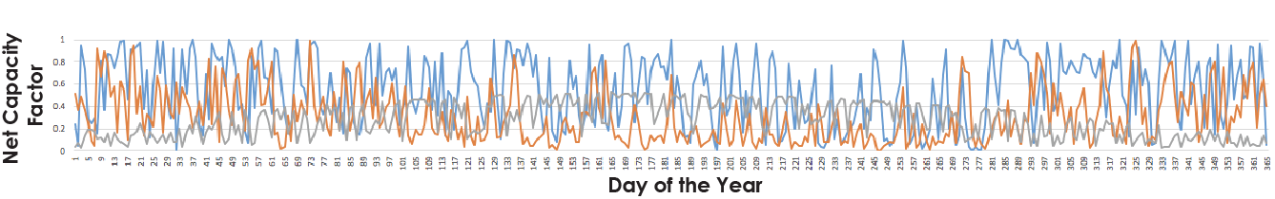
Case Study: Gulf of Maine
Region:
Sparsely populated
Strong but intermittent winds offshore
Size of Wind Farm: 600 MW
Standard Deviation
30.5%
24.4%
15.3%
Pledged 5,000 MW by 2030

Slide 3
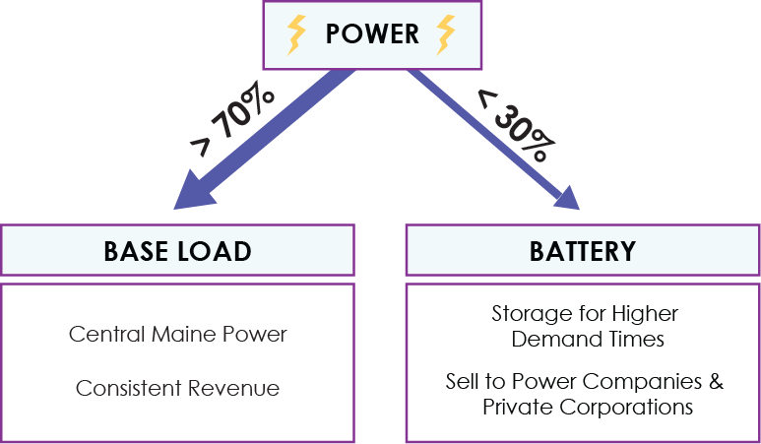
Energy Storage Strategy

Slide 4
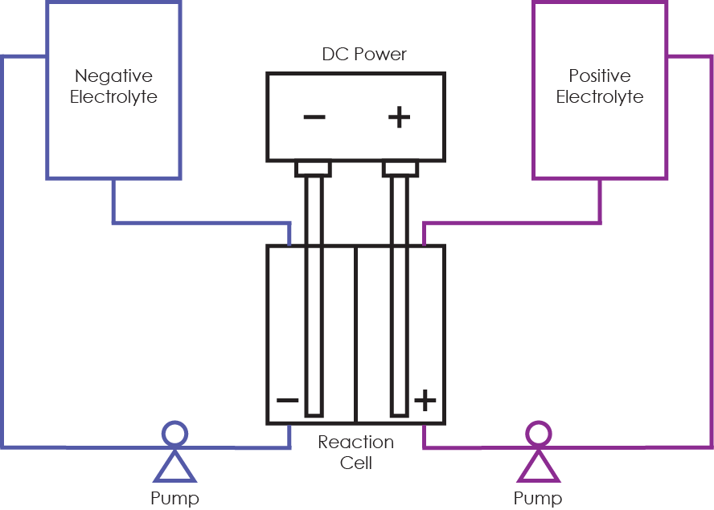
Redox Flow Batteries
Advantages:
Power & energy are independent
Quick discharge
Fast reaction time
Low maintenance costs
Size of Battery: 1MW (0.5MWh)

Slide 5

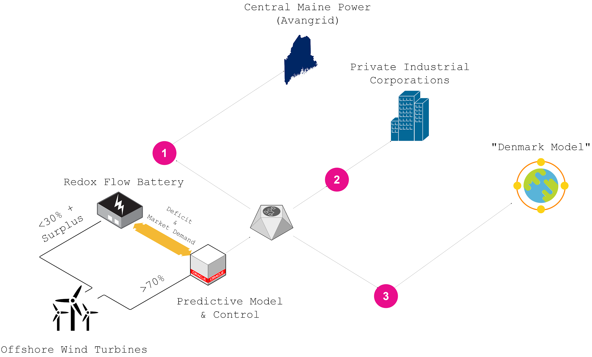
Revenue Streams

Slide 6
Financial Model
Total Annual Revenue: ~$127 Million
~$62 Million annual revenue from sales to Central Maine Power
~$65 Million annual revenue from battery-based sales
Total Annual Expenditure: ~$77 Million
Capital cost of redox flow battery: ~$36 Million
Maintenance and operating expenses for battery: ~$15 Million
Maintenance and operating expenses for wind farm: ~$62 Million
Net Annual Profit: ~$50 Million

Slide 7
References
ttps://spectrum.ieee.org/energywise/energy/renewables/underwater-energy-bags-for-the-london-array
http://www.ipsnews.net/2018/06/masdar-equinor-inaugurate-worlds-first-battery-storage-facility-connected-offshore-wind-farm/
https://ieeexplore-ieee-org.ezp-prod1.hul.harvard.edu/document/6981515
https://www.eia.gov/electricity/state/maine/
https://www.electricitylocal.com/states/maine/
https://www.energy.ca.gov/almanac/electricity_data/us_per_capita_electricity.html
https://composites.umaine.edu/offshorewind/resourcemapwhitebg/
https://www.eia.gov/analysis/studies/electricity/batterystorage/pdf/battery_storage.pdf
https://www-sciencedirect-com.ezp-prod1.hul.harvard.edu/science/article/pii/S0196890413005517
https://www-sciencedirect-com.stanford.idm.oclc.org/science/article/pii/S0306261918304811
https://onlinelibrary-wiley-com.ezp-prod1.hul.harvard.edu/doi/epdf/10.1002/er.3858
https://pdfs.semanticscholar.org/1750/7c614c7d5379c6698dd61d3fcb7f28e10f9f.pdf

